Slide 1
Osteoarthritis
QUALITY STANDARDS
Guiding evidence-based care for Adults With Osteoarthritis of the Knee, Hip, Hand, or Shoulder
Notes:
If you have any questions about the content of this presentation, please contact us at QualityStandards@OntarioHealth.ca

Slide 2
Objectives
Overview of quality standards: What are they? How are they used?​
Why this quality standard is needed: Gaps and variations in quality of care for people with osteoarthritis in Ontario
Quality statements to improve care: The key statements in the
osteoarthritis quality standard
Measures to support improvement: Indicators that can help measure your quality improvement efforts
2

Slide 3
Quality standards
Inform clinicians and patients what quality care looks like
Focus on conditions or processes where there are large variations in how care is delivered, or where there are gaps between the care provided in Ontario and the care patients should receive
Are grounded in the best available evidence
3
Notes:
Quality standards are a small set of high impact statements that describe optimal care where identified quality gaps exist in Ontario.
Voluntary and aspirational in nature​.
Designed to “raise the ceiling” with the goal of having the best possible care available to all Ontarians, regardless of where they live in the province.
There are many guidelines, professional standards, and other recommendations that contribute to the evidence ecosystem. Quality standards complement these resources.
Quality standards outline the what of care that should be delivered but are agnostic on who should be delivering it (unlike other CPGs, BPGs).
Quality standards are:
Concise: 5 to 15 strong, evidence-based statements focused on high-priority areas for improvement.
Accessible: help clinicians and provider organizations offer the highest-quality care; and patients to know what to discuss with their health care team (compared with CPGs that are quite dense, these are very accessible, also written in plain language).
Measurable: each statement is accompanied by one or more quality indicators (structure, process, or outcome), with a set of outcome measures for the overall standard.
Implementable: quality improvement tools and resources support each standard, to fuel adoption.

Slide 4
Quality standards
Help patients, residents, families, and care partners know what to ask for in their care
Help clinicians know what care to offer, based on evidence and expert consensus
Help health care organizations measure, assess, and improve the quality of care they provide
Help ensure consistent,
high-quality care across
the province
4
Notes:
Patients, caregivers and the public can use quality standards to understand what excellent care looks like, what they should expect from their health care team, and how to discuss the quality of their care.
Provincial regions and disease agencies can use quality standards to measure health outcomes, hold health service providers accountable for delivering high-quality care, and inform regional improvement strategies.
Provider organizations can use quality standards to measure and audit their quality of care, identify gaps, guide organizational improvement strategies, and inform clinical program investments.
Clinicians can use quality standards to evaluate their practice and identify areas for personal and organizational quality improvement, and can incorporate the evidence-based statements into professional education.
Government can use quality standards to identify provincial priority areas, inform new data collection and reporting initiatives, and design performance indicators and funding incentives.

Slide 5
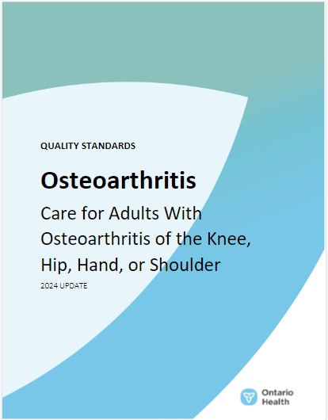
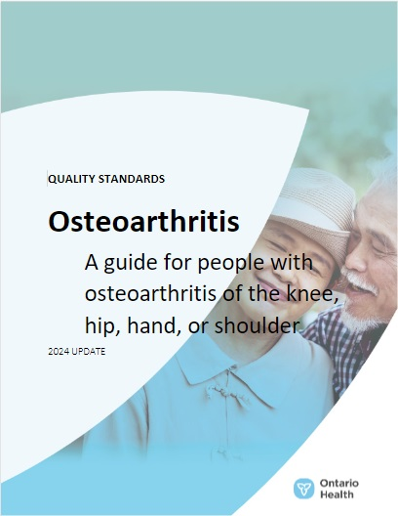
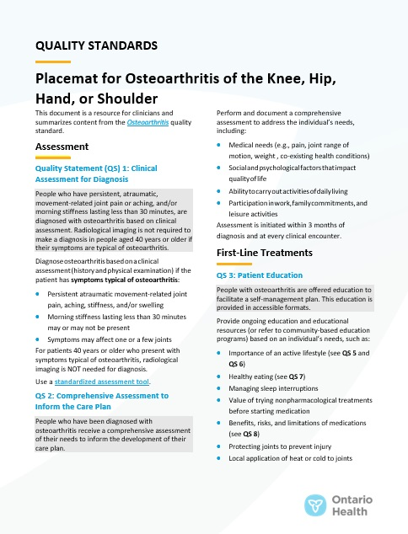
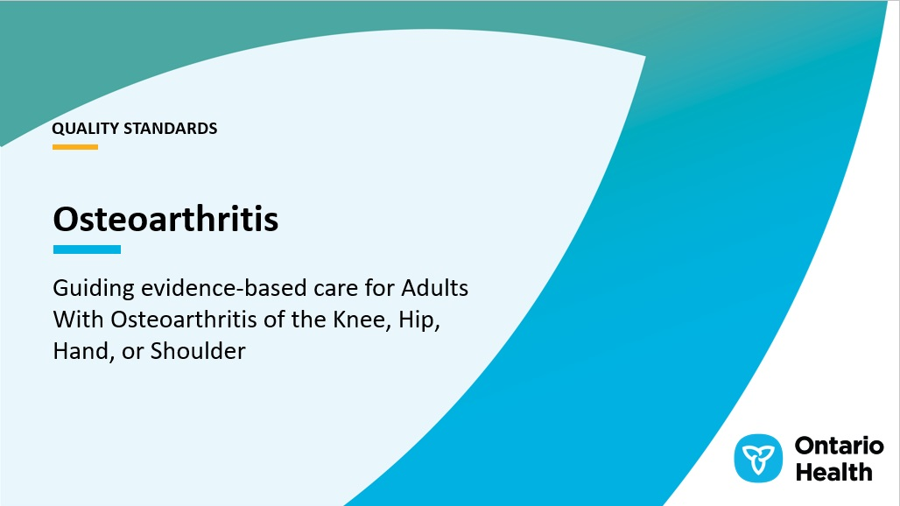
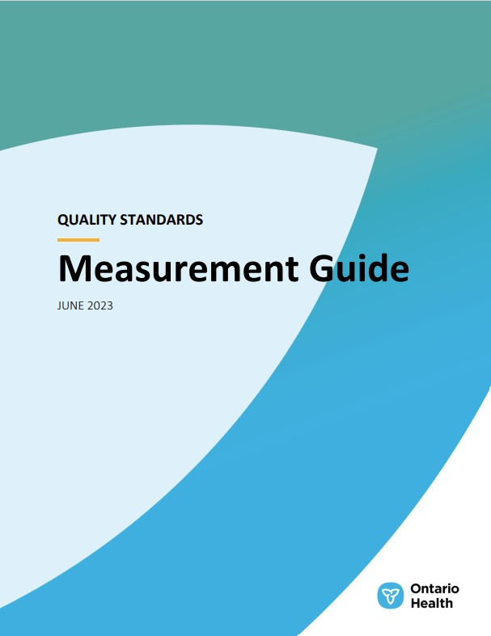

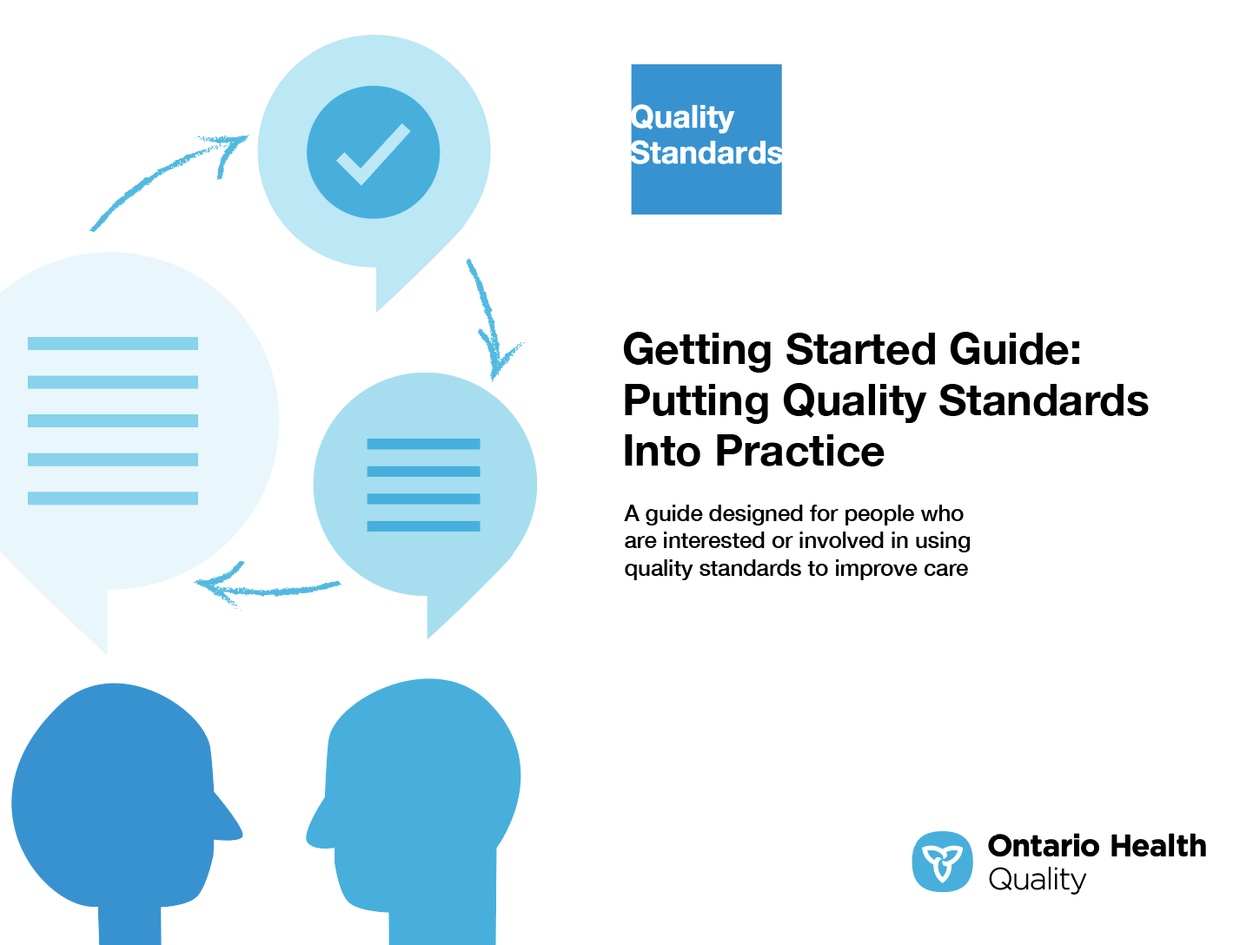
Quality standard resources
Quality Standard
Patient Guide
Placemat
Case for Improvement Deck
Measurement Guide
Technical Specifications
Getting Started Guide
Find these resources here:
https://www.hqontario.ca/evidence-to-improve-care/quality-standards/view-all-quality-standards/osteoarthritis
5
Notes:
Each quality standard focuses on a specific health care issue. The development of each quality standard is accompanied by an assortment of resources.
Through concise, easy-to-understand statements, quality standards outline what quality care looks like for a condition or topic based on the evidence.
Each quality standard is accompanied by a:
Patient guide
Placemat
Case for Improvement Deck
Measurement guide
Technical specifications
Getting started guide
Quality standards provide the blueprint to enable the health care system in Ontario to work better, facilitate smooth transitions, and ensure patients receive the same high-quality care, regardless of where they reside.

Slide 6
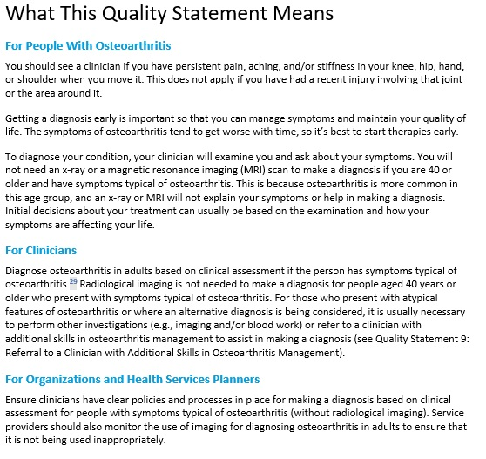
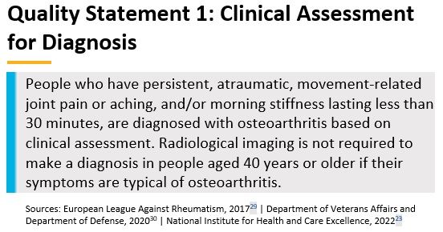
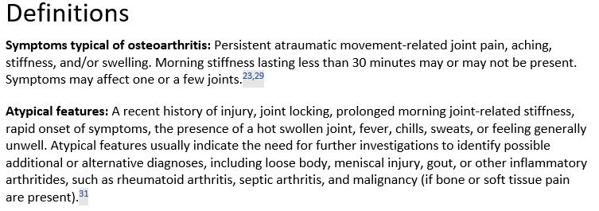
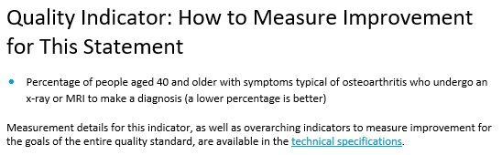
Inside the quality standard
The Audience Statements
The Quality Statement
The Definitions
The Indicators
6

Slide 7
Patient guide
Quality standards
The patient guide is designed to give patients information about what quality care looks like for various conditions based on the best evidence, so they can ask informed questions of their clinicians.
7
Notes:
Every quality standard includes a plain language summary for patients, families, caregivers and the public called the patient guide.
Patient engagement in quality standards:
Membership on advisory committees
Focus groups and key informant interviews on topic-specific content (when necessary)
Public comment period for each quality standard
Consultations on the patient guide

Slide 8
Placemat
Quality standards
The placemat is a quick-reference resource
for clinicians that summarizes the quality standard and includes links to helpful resources and tools.
8

Slide 9
Case for improvement deck
Quality standards
The case for improvement deck describes why the quality standard was created and shows some of the data used to develop it. Champions can use or adapt this deck to build support for the quality standard in their organizations.
9

Slide 10
How the health care system can support implementation
Quality standards
Implementing quality standards can be challenging owing to
system-level barriers or gaps, many of which have been identified throughout the development and update of this standard
Ontario Health will work with and support other provincial partners, including the Ministry of Health, to bridge system-level gaps to support the implementation of quality standards
10

Slide 11
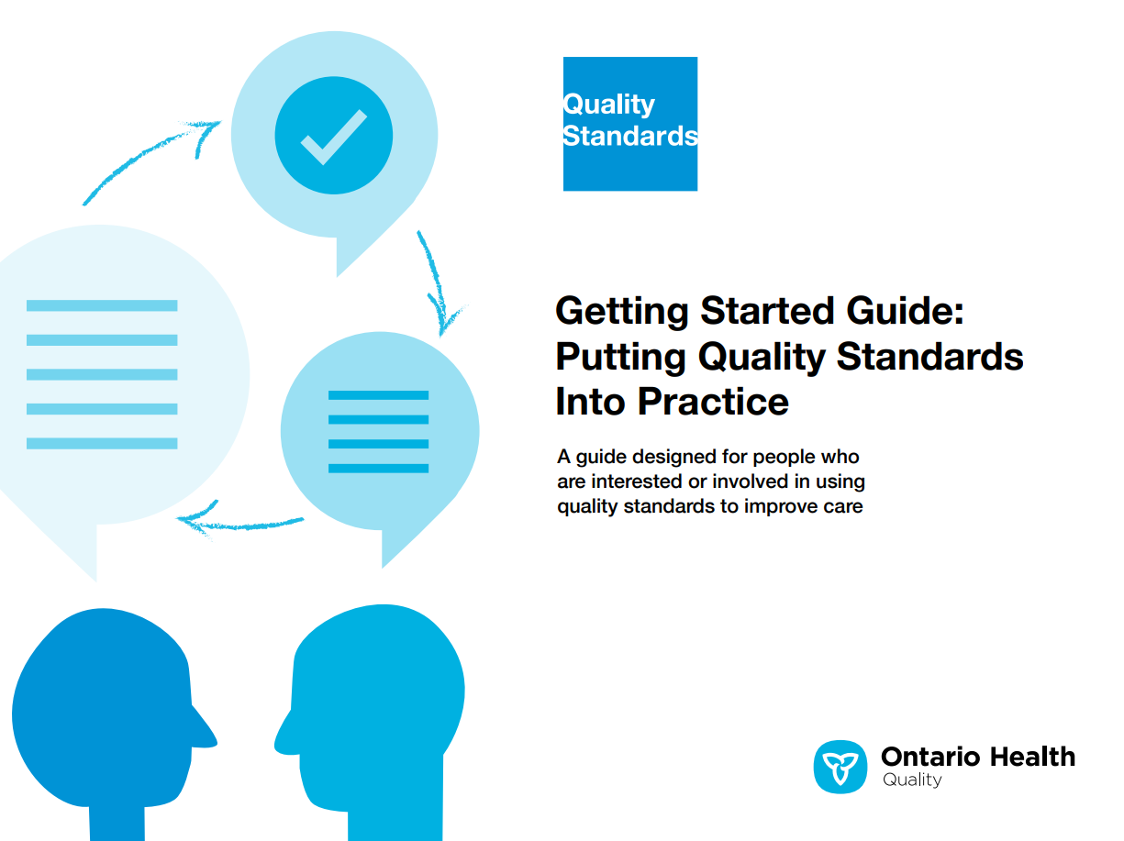
Implementation tools
Quality standards
The Getting Started Guide:
Outlines the process for using the quality standard as a resource to deliver
high-quality care
Contains evidence-based approaches, as well as useful tools and templates for implementing change ideas at the
practice level
11
Notes:
There are things we can do today despite the larger systemic barriers that may take time to resolve. The Getting Started Guide is a document that outlines a process for using the quality standards as a resource to deliver high-quality care. It compiles a number of resources to support adoption, such as links to implementation and quality improvement resources, examples and activities for reflection, and templates and documents to support the implementation planning activities. The Getting Started Guide also includes an Action Plan Template and examples on how Quality Improvement Plans can help to advance quality standards.

Slide 12

Quorum
Quality standard adoption tools
Quorum is an online community dedicated to improving the quality of health care in Ontario.
The Quality Standards Adoption Series highlights efforts in the field to implement changes and close gaps in care related to quality standard topics.
12
quorum.hqontario.ca
Notes:
The Quality Standards program has highlighted several stories from organizations and groups using various standards and statements within their clinical care settings, organization, or institutions; these are available through posts and discussions on Quorum.
As well, we are working on compiling resources and tools, for both clinicians and patients and families.
The focus is on implementation/adoption stories and how organizations are using quality standards in practice to inform care.
We’d love to hear from you if you are interested in contributing to a post or article.

Slide 13
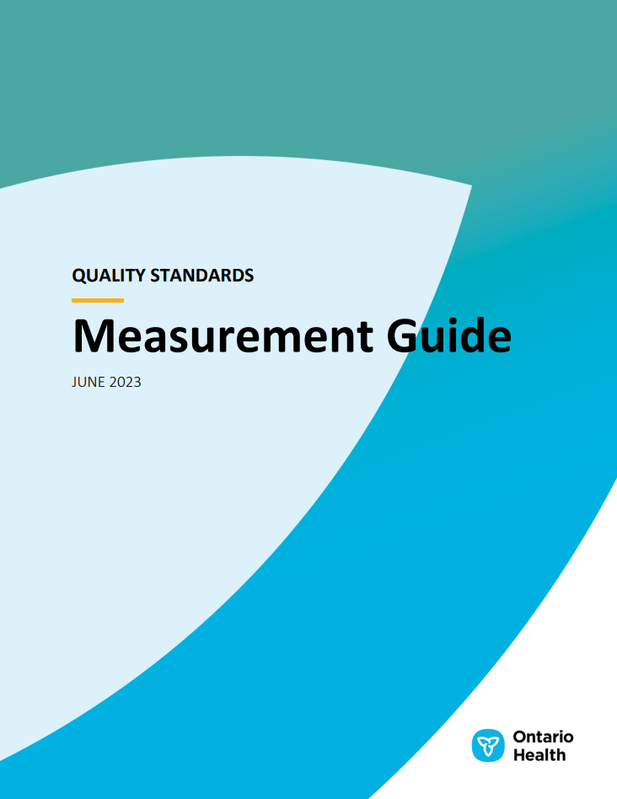
Measurement guide
Quality standards
The measurement guide describes:
The measurement principles behind the quality indicators included in quality standards
The types of indicators included in quality standards
How local and provincial data are collected and measured
13

Slide 14
Technical specifications
Quality standards
The technical specifications report outlines
2 types of measurement:
Provincial measurement: how we can monitor the progress being made to improve care at the provincial level
Local measurement: what you can do to assess the quality of care that you
provide locally
14

Slide 15
Why do we need a quality standard for
Osteoarthritis?

Slide 16
About 1 in 7 adults in Ontario are living with osteoarthritis
Osteoarthritis Quality Standard
Key Trends
Approximately 14% of people in Ontario aged 20 and above are currently living with osteoarthritis
Prevalence has increased in recent years, and this trend is expected to continue as the population in Ontario ages
The prevalence of osteoarthritis increases with age, and this trend is especially pronounced among women aged 75 to 79
Values were calculated by applying methodology from the Arthritis Society Special Report: The burden of osteoarthritis in Canada to data from the Ontario Share files of the Canadian Community Health Survey, 2021.
Arthritis Community Research and Evaluation Unit (ACRUE). Special Report: The burden of osteoarthritis in Canada. Toronto, ON: Arthritis Society, 2021.
16

Slide 17


Osteoarthritis negatively impacts activities of daily living
Osteoarthritis Quality Standard
Symptoms typical of osteoarthritis include movement-related joint pain, aching, stiffness, and swelling of the joints.^{1,2}
Joint pain from osteoarthritis often decreases quality of life due to muscle weakness and reduced mobility and functional movement, which are significant barriers to healthy and happy aging.³
  ↓ Participation in meaningful activities
  ↑ Difficulty participating in the workforce
  ↑ Social isolation
1. Hawker GA, King LK. The burden of osteoarthritis in older adults. Clin Geriatr Med. 2022 May;38(2):181-192. doi: 10.1016/j.cger.2021.11.005. PMID: 35410675.
2. Atukorala I, Hunter DJ. A review of quality-of-life in elderly osteoarthritis. Expert Rev Pharmacoecon Outcomes Res. 2023 Apr;23(4):365-381. doi: 10.1080/14737167.2023.2181791. Epub 2023 Feb 26. PMID: 36803292.
3. Yan H, Guo J, Zhou W, Dong C, Liu J. Health-related quality of life in osteoarthritis patients: a systematic review and meta-analysis. Psychol Health Med. 2022 Sep;27(8):1859-1874. doi: 10.1080/13548506.2021.1971725. Epub 2021 Aug 31. PMID: 34465255.
17

Slide 18

Osteoarthritis creates substantial societal burden
Osteoarthritis Quality Standard
Health Care Utilization
In Ontario, osteoarthritis has one of the highest physician visit rates among musculoskeletal disorders.¹
  In ambulatory care settings in 2013/14, the rate was 51 person-visits per 1,000 people aged 18+, and 127.4 person-visits per 1,000 population for people aged 65+¹
A 2022 study found $400 million of Ontario's health care spending to be attributed directly to osteoarthritis.¹
  86% of spending was due to inpatient hospitalizations¹
  Joint replacement surgery is the single largest contributor to direct health care costs for osteoarthritis²
  Imaging, pharmacologic treatments, and physician time are also notable costs³
Economic Burden
Osteoarthritis is a predictor of a lower rate of employment and an early exit from the workforce.³
Compared to those without osteoarthritis, people with osteoarthritis report losing twice as much productive time at work due to absenteeism stemming from their symptoms.³
1. Power JD, Perruccio AV, Paterson JM, Canizares M, Veillette C, Coyte PC, et al. Healthcare utilization and costs for musculoskeletal disorders in Ontario, Canada. J Rheumatol. 2022 Jul;49(7):740-747. doi: 10.3899/jrheum.210938. Epub 2022 Apr 1. PMID: 35365584.
2. Hawker GA, King LK. The burden of osteoarthritis in older adults. Clin Geriatr Med. 2022 May;38(2):181-192. doi: 10.1016/j.cger.2021.11.005. PMID: 35410675.
3. Scheuing WJ, Reginato AM, Deeb M, Acer Kasman S. The burden of osteoarthritis: is it a rising problem? Best Pract Res Clin Rheumatol. 2023 Jun;37(2):101836. doi: 10.1016/j.berh.2023.101836. Epub 2023 Aug 24. PMID: 37633827.
18

Slide 19


Osteoarthritis is associated with many comorbidities
Osteoarthritis Quality Standard
The risk of cardiovascular-related death is 21% higher for individuals with hip and knee osteoarthritis¹
Joint pain can reduce mobility and limit physical activity. A more sedentary lifestyle may contribute to cardiovascular, musculoskeletal, and metabolic conditions.^{1,2,3}
The risk of type 2 diabetes is 40% higher among individuals with osteoarthritis¹
Approximately 40% of adults with osteoarthritis report clinically significant fatigue¹
Joint pain can also lead to psychological disorders that may exacerbate associated symptoms such as pain, sleep quality, and depressed mood.^{1,4}
1. Hawker GA, King LK. The burden of osteoarthritis in older adults. Clin Geriatr Med. 2022 May;38(2):181-192. doi: 10.1016/j.cger.2021.11.005. PMID: 35410675.
2. Constantino de Campos G, Mundi R, Whittington C, Toutounji MJ, Ngai W, Sheehan B. Osteoarthritis, mobility-related comorbidities and mortality: an overview of meta-analyses. Ther Adv Musculoskelet Dis. 2020 Dec 25;12:1759720X20981219. doi: 10.1177/1759720X20981219. PMID: 33488786; PMCID: PMC7768583.
3. Atukorala I, Hunter DJ. A review of quality-of-life in elderly osteoarthritis. Expert Rev Pharmacoecon Outcomes Res. 2023 Apr;23(4):365-381. doi: 10.1080/14737167.2023.2181791. Epub 2023 Feb 26. PMID: 36803292.
4. Fonseca-Rodrigues D, Rodrigues A, Martins T, Pinto J, Amorim D, Almeida A, et al. Correlation between pain severity and levels of anxiety and depression in osteoarthritis patients: a systematic review and meta-analysis. Rheumatology (Oxford). 2021 Dec 24;61(1):53-75. doi: 10.1093/rheumatology/keab512. PMID: 34152386.
19

Slide 20


Osteoarthritis pain cascade
Osteoarthritis Quality Standard
Difficulty walking
↑ Risks and complications for diabetes, heart disease,
all-cause mortality
Disability
Pain
Pain
Depressed
Mood
SLEEP
Fatigue
Hawker GA, Gignac MA, Badley E, Davis AM, French MR, Li Y, et al. A longitudinal study to explain the pain-depression link in older adults with osteoarthritis. Arthritis Care Res (Hoboken). 2011;63(10):1382-90.
Wilkie R, Blagojevic-Bucknall M, Jordan KP, Lacey R, McBeth J. Reasons why multimorbidity increases the risk of participation restriction in older adults with lower extremity osteoarthritis: a prospective cohort study in primary care. Arthritis Care Res (Hoboken). 2013;65(6):910-9.
Hawker GA, King LK. The burden of osteoarthritis in older adults. Clin Geriatr Med. 2022 May;38(2):181-192. doi: 10.1016/j.cger.2021.11.005. PMID: 35410675.
20

Slide 21
Osteoarthritis management
Osteoarthritis Quality Standard
Third-line:
Surgery
Second-line: Pharmacological symptom management, aids and devices; passive treatments given by a clinician
First-line: Education, self-management, exercise
(therapeutic exercise and physical activity), and
weight management
In Canada, 99.4% of knee replacements (53,058 procedures) and 69.3%
of hip replacements (36,632 procedures) performed in 2021/22 were
for osteoarthritis¹
In Ontario, the rate of hospitalization was 175 per 100,000 population for knee replacement and 164 per 100,000 population for hip replacement¹
Target
group
^{Current care delivered}
FEW
Over 90% of people with knee osteoarthritis use pharmacologic treatment (including nonsteroidal anti-inflammatory drugs, acetaminophen, intra-articular corticosteroid injection)^{2,3,4}
About 30% of people with knee osteoarthritis reported using opioid analgesics at the time of assessment for surgery⁴
SOME
Only 19% of people with knee osteoarthritis that did not require surgery report receiving education, exercise, or weight management²
44% of people with knee osteoarthritis that required surgery report receiving physiotherapy³
52% of primary care clinicians and 29% of physiotherapists find best-practice nonpharmacologic and nonsurgical osteoarthritis care to be too time consuming⁶
ALL
1. Canadian Institute for Health Information. Hip and knee replacements in Canada: CJRR Annual Report, 2021–2022. Ottawa, ON: CIHI; 2023.
2. Mazzei DR, Whittaker JL, Kania-Richmond A, Faris P, Wasylak T, Robert J, et al. Do people with knee osteoarthritis use guideline-consistent treatments after an orthopaedic surgeon recommends nonsurgical care? A cross-sectional survey with long-term follow-up. Osteoarthr Cartil Open. 2022 Mar 28;4(2):100256. doi: 10.1016/j.ocarto.2022.100256. PMID: 36475282; PMCID: PMC9718222
3. King LK, Marshall DA, Faris P, Woodhouse LJ, Jones CA, Noseworthy T, et al. Use of recommended non-surgical knee osteoarthritis management in patients prior to total knee arthroplasty: a cross-sectional study. J Rheumatol. 2020 Aug 1;47(8):1253-1260. doi: 10.3899/jrheum.190467. Epub 2019 Nov 15. PMID: 31732554
4. King LK, Marshall DA, Jones CA, Woodhouse LJ, Ravi B, Faris PD, et al. Are medical comorbidities contributing to the use of opioid analgesics in patients with knee osteoarthritis? Osteoarthritis Cartilage. 2020 Aug;28(8):1030-1037. doi: 10.1016/j.joca.2020.04.012. Epub 2020 May 7. PMID: 32387761.
5. Johnson, A., Milne, B., Pasquali, M. et al. Long-term opioid use in seniors following hip and knee arthroplasty in Ontario: a historical cohort study. Can J Anesth/J Can Anesth. 69:934–944 (2022). https://doi.org/10.1007/s12630-021-02091-2
6. Briggs AM, Houlding E, Hinman RS, Desmond LA, Bennell KL, Darlow B, et al. Health professionals and students encounter multi-level barriers to implementing high-value osteoarthritis care: a multi-national study. Osteoarthritis Cartilage. 2019 May;27(5):788-804. doi: 10.1016/j.joca.2018.12.024. Epub 2019 Jan 19. PMID: 30668988
21

Slide 22


Exercise and weight loss are important treatment strategies for people with osteoarthritis who are overweight or obese
Osteoarthritis Quality Standard
For every 5 kg/m² increase in body mass index (BMI), the risk of developing knee osteoarthritis increases by 35%¹; the risk of developing hip osteoarthritis increases by 11%²
Among people with osteoarthritis, BMI values for obesity (> 30 kg/m²) and a waist circumference categorized as large (men: ≥ 102 cm; women: ≥ 88 cm) are risk factors for mobility issues³
Exercise-based interventions can reduce pain and improve physical function of the affected joint⁴
In a Canadian cohort of people with osteoarthritis, it was found that only
  63% of individuals reported meeting the exercise threshold of 55 minutes/week after consultation with an orthopedic surgeon⁵
  37% of individuals with a BMI > 25 kg/m² (overweight or obese) reported attempting weight management after consultation with an orthopedic surgeon⁵
1. Jiang L, Tian W, Wang Y, Rong J, Bao C, Liu Y, et al. Body mass index and susceptibility to knee osteoarthritis: a systematic review and meta-analysis. Joint Bone Spine. 2012 May;79(3):291-7. doi: 10.1016/j.jbspin.2011.05.015. Epub 2011 Jul 30. PMID: 21803633
2. Jiang L, Rong J, Wang Y, Hu F, Bao C, Li X, et al. The relationship between body mass index and hip osteoarthritis: a systematic review and meta-analysis. Joint Bone Spine. 2011 Mar;78(2):150-5. doi: 10.1016/j.jbspin.2010.04.011. Epub 2010 Jun 30. PMID: 20580591
3. Gill SV, Hicks GE, Zhang Y, Niu J, Apovian CM, White DK. The association of waist circumference with walking difficulty among adults with or at risk of knee osteoarthritis: the Osteoarthritis Initiative. Osteoarthritis Cartilage. 2017 Jan;25(1):60-66. doi: 10.1016/j.joca.2016.07.011. Epub 2016 Aug 1. PMID: 27492464; PMCID: PMC5182140
4. McAlindon TE, Bannuru RR, Sullivan MC, Arden NK, Berenbaum F, Bierma-Zeinstra SM, et al. OARSI guidelines for the non-surgical management of knee osteoarthritis. Osteoarthritis Cartilage. 2014 Mar;22(3):363-88. doi: 10.1016/j.joca.2014.01.003. Epub 2014 Jan 24. PMID: 24462672
5. Mazzei DR, Whittaker JL, Kania-Richmond A, Faris P, Wasylak T, Robert J, et al. Do people with knee osteoarthritis use guideline-consistent treatments after an orthopaedic surgeon recommends nonsurgical care? A cross-sectional survey with long-term follow-up. Osteoarthr Cartil Open. 2022 Mar 28;4(2):100256. doi: 10.1016/j.ocarto.2022.100256. PMID: 36475282; PMCID: PMC9718222
22

Slide 23

Referral for consideration of joint surgery should be discussed only for appropriate procedures after an adequate trial of nonsurgical management
Osteoarthritis Quality Standard
There is no role for arthroscopic surgery in the management of knee osteoarthritis (see QS 10).
About 13% of patients who received a total knee replacement between 2007 and 2017 in Ontario also received knee arthroscopy in the 3 years prior to their procedure, despite high quality evidence showing that this intervention does not reduce pain or improve function in patients with knee osteoarthritis¹
About 12% of patients who received a total knee replacement between 2007 and 2017 in Ontario also received magnetic resonance imaging (MRI) in the year prior to their knee replacement, even though MRIs are not required and may lead to unwarranted and ineffective knee arthroscopies to treat incidental findings¹
1. Marsh JD, Degen R, Birmingham TB, Giffin JR, Getgood A, Litchfield R, et al. The rate of unnecessary interventions for the management of knee osteoarthritis: a population-based cohort study. Can J Surg. 2022 Feb 18;65(1):E114-E120. doi: 10.1503/cjs.002221. PMID: 35181579; PMCID: PMC8863184
23

Slide 24
Quote from Anna Larson, Lived Experience Advisor
”
“Recreational soccer joint injuries led to the development of osteoarthritis in my knees. After a long wait to see a surgeon who I thought would fix my ligament issue, I learned that my existing osteoarthritis would negate any benefit of surgery. I left the office in tears.
My wish is that the Osteoarthritis Quality Standard will enable clinicians to provide patients with hope by letting them know that there are resources available and steps they can take.
Physical activity and weight management can delay or even eliminate the need for joint replacement surgery, as can working with a clinician to develop a care plan. For those with osteoarthritis, this standard also provides the facts about what works and what doesn’t. This is so valuable given the volume of inaccurate and damaging quick fixes being flogged daily.”
– Anna Larson, Lived Experience Advisor, Osteoarthritis Quality Standard Advisory Committee
24

Slide 25
Quote from Joan Conrad, Lived Experience Advisor
”
“There are many misconceptions surrounding osteoarthritis and a range of advice to sift through. General education for people with osteoarthritis is lacking, particularly around the importance of exercise to manage disease progression. The quality statements provide a springboard for discussion, helping to structure conversations with [clinicians], and highlight the key role of the primary care physician in providing continuous care.
Ten years ago, I had trouble going up and down the stairs. Initial opinion was that I didn’t have osteoarthritis, despite a family history. I started physiotherapy, which was helpful, but a diagnosis didn’t come until I was able to get an x-ray. Afterwards, there was no discussion about daily exercise, physical fitness, and overall health. My mother had a similar disease trajectory; she was referred for surgery, which she initially did not pursue, and later in life when she was ready for surgery she was turned down for the procedure. The impact on her life was visible; she has reduced mobility and experiences a lot of pain. Her experiences have inspired me to be proactive about my condition.
This quality standard will encourage early identification and will offer more options for individuals at initial stages of their disease, while closing the information gap within the health care system.”
– Joan Conrad, Lived Experience Advisor, Osteoarthritis Quality Standard Advisory Committee
25

Slide 26
Quote from Zahra Bardai, Family Physician
”
“This quality standard is a comprehensive set of agreed-upon principles to improve care for patients with osteoarthritis. It does not overwhelm the [clinician] with what they need to know, but rather allows for the art of medicine – shaping the patient’s health destiny and creating an appropriate path of care.
There are many gaps in knowledge regarding the management of chronic musculoskeletal conditions, specifically the necessary role of mobility, physical activity, and weight management. Osteoarthritis is a pervasive condition that highlights overarching and underlying conditions. Although the morbidity and mortality associated with osteoarthritis is not as high as with other conditions, it does affect quality of life and it makes other conditions more difficult to manage. The vast majority of patients are not eligible for surgery, but patients can be empowered to make lifestyle changes and improve their outcomes. The quality standard is a great starting off point to ensure that there is a framework in place for patient and clinician education on these key issues pertaining to self-management.
The most important next step is implementation: the ‘how’ part is key, including identifying available resources that support the care framework outlined in the quality statements.”
– Zahra Bardai, Family Physician, Osteoarthritis Quality Standard Advisory Committee
26

Slide 27
Quality statements to improve care

Slide 28
Scope of this quality standard
This quality standard focuses on the assessment, diagnosis, and management of osteoarthritis for people across all health care settings and clinicians. It provides guidance on nonpharmacological and pharmacological care
It addresses care for adults (18 years of age or older) with osteoarthritis of the knee, hip, hand (i.e., thumb or fingers), or shoulder (i.e., the glenohumeral joint)
It covers referral for consideration of joint surgery, but does not address specific surgical procedures
This quality standard does not apply to care for people with osteoarthritis affecting the spine, other peripheral joints (i.e., elbow, wrist, foot, ankle), or neck or low back pain. It also excludes people with inflammatory arthritis or medical conditions and treatments that can lead to osteoarthritis
28
Notes:
Scope of This Quality Standard
This quality standard addresses
A separate quality standard addresses

Slide 29
Quality statement topics
Clinical assessment for diagnosis
Comprehensive assessment to inform the care plan
Patient education
Patient self-management plan
Therapeutic exercise
Physical activity
Weight management
Pharmacological symptom management
Referral to a clinician with additional skills in osteoarthritis management
Referral for consideration of joint surgery
29

Slide 30
Clinical assessment for diagnosis
Quality statement 1:
People who have persistent, atraumatic, movement-related joint pain or aching, and/or morning stiffness lasting less than 30 minutes, are diagnosed with osteoarthritis based on clinical assessment. Radiological imaging is not required to make a diagnosis in people aged 40 years or older if their symptoms are typical of osteoarthritis.
30

Slide 31
Comprehensive assessment to inform the care plan
Quality statement 2:
People who have been diagnosed with osteoarthritis receive a comprehensive assessment of their needs to inform the development of their care plan.
31

Slide 32
Patient education
Quality statement 3:
People with osteoarthritis are offered education to facilitate a self-management plan. This education is provided in accessible formats.
32

Slide 33
Patient self-management plan
Quality statement 4:
People with osteoarthritis are supported to develop an individualized, goal-oriented self-management plan that evolves to address ongoing symptom management and access to resources and supports.
33

Slide 34
Therapeutic exercise
Quality statement 5:
People with osteoarthritis are strongly encouraged to participate in progressive neuromuscular training, muscle strengthening, and aerobic exercise of sufficient frequency, intensity, and duration to maintain or improve joint health and physical fitness.
34

Slide 35
Physical activity
Quality statement 6:
People with osteoarthritis are strongly encouraged to optimize their physical activity and minimize sedentary activity, and are offered information and support to help them toward these goals.
35

Slide 36
Weight management
Quality statement 7:
People with osteoarthritis who are overweight or obese are offered patient-centred weight-management strategies, and people at a normal weight are encouraged to maintain their weight.
36

Slide 37
Pharmacological symptom management
Quality statement 8:
People with symptomatic osteoarthritis are offered pain-relieving medication options when nonpharmacological treatments are insufficient to control their symptoms.
37

Slide 38
Referral to a clinician with additional skills in osteoarthritis management
Quality statement 9:
People with osteoarthritis, when clinically indicated, are referred by their primary care clinician to a clinician with additional skills in osteoarthritis management.
38

Slide 39
Referral for consideration of joint surgery
Quality statement 10:
People with osteoarthritis whose symptoms are not sufficiently controlled through nonsurgical management and whose quality of life is negatively impacted by their joint-related symptoms should be referred for consideration of joint surgery.
39

Slide 40
Measures to support improvement

Slide 41
Indicators that can be measured using provincial data
None identified
41

Slide 42
Indicators that can be measured using only local data
Indicator 1: Percentage of people with osteoarthritis who report the long-term control of their pain as acceptable
Indicator 2: Percentage of people with osteoarthritis who report a high level of success in coping with and self-managing their condition
Indicator 3: Percentage of people with osteoarthritis who have timely access to appropriate rehabilitation management strategies (e.g., education, exercise, and weight management)
Indicator 4: Median wait time to first appointment with a clinician with additional skills in osteoarthritis management (i.e., additional skills in rheumatology, orthopaedic surgery, sport and exercise medicine, or
pain management)
Indicator 5: Percentage of people with osteoarthritis referred to a clinician with additional skills in osteoarthritis management (i.e., additional skills in rheumatology, orthopaedic surgery, sport and exercise medicine, or pain management) who have their first appointment in a timely manner
42

Slide 43
Data sources and acknowledgement
Some of the data used in this presentation were sourced from the Canadian Community Health Survey Ontario Share Files, developed by Statistics Canada and provided by Ontario’s Ministry of Health. The views expressed in the report are those of Ontario Health, and do not necessarily reflect those of Ontario, the Ministry of Health, or Statistics Canada. The opinions, results, and conclusions included in this presentation are those of the authors and are independent from the data providers and funding sources.
43

Slide 44
Thank you

